Slide 1

Weather Forecast:
Advanced Topics in Data Analysis - Spring 2019
Group members: Anna, Mark
Instructor: Vardan Baghdasaryan

Slide 2
Overview
Importance
Data
Models
Results
Conclusion
2015 | 2016 | 2017 | 2018

Slide 3
Importance
Weather relates to almost all the aspects of our lives:
Distribution of the population
Day-to-day activity
Transportation
Agriculture

Slide 4
Data: Modification
Initial data: 36243 observations
Missing data (1 year gap)
Used data: 1400 observations (resampled daily)
Transformation (Kelvin to Celsius)
Normalization (Standard scaling)

Slide 5
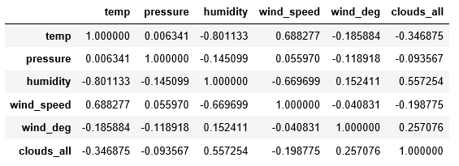
Data: Correlation
The temperature, that is our dependent variable shows a significantly high correlation with humidity and speed of the wind.

Slide 6
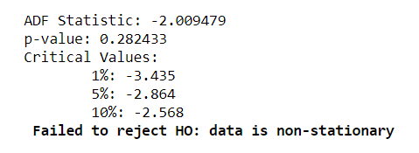
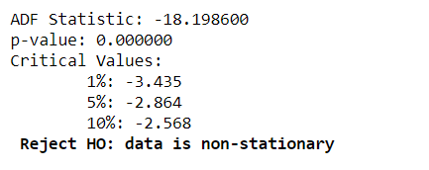
Models: Stationarity
Augmented Wickey-Fuller Test
H0: States that data is non-stationary, time dependent structure
H1: Data does not have time dependent structure

Slide 7
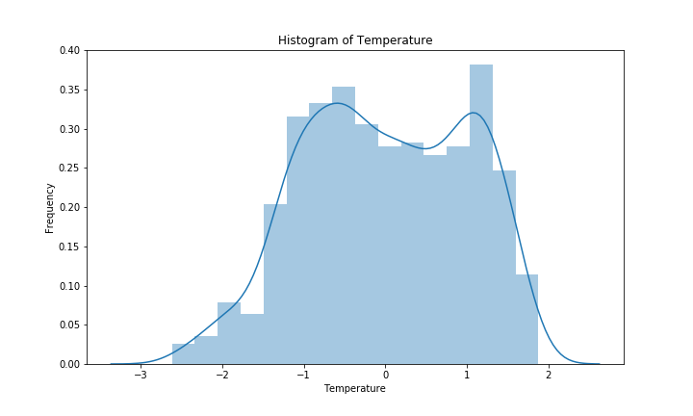
Distribution of response

Slide 8
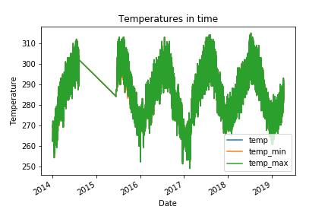
Response variable
Gap between 2014 and 2016
Last winters warmer..

Slide 9
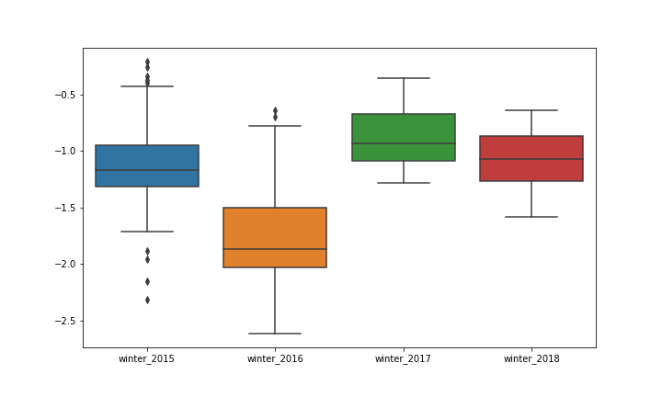
T-test
Variances:
winter_2015 0.15
winter_2016 0.19
winter_2017 0.07
winter_2018 0.06
Means:
winter_2015 -1.12
winter_2016 -1.78
winter_2017 -0.88
winter_2018 -1.07
T-test 2016 vs 2018: (statistic=-14.7, p-value=1.3e-25)
T-test 2015 vs 2018: (statistic=-1.21, p-value=0.23)
T-test 2016 vs 2017: (statistic=-15.5, p-value=4.6e-27)
T-test 2015 vs 2017: (statistic=-6.6, p-value=2.63e-09)

Slide 10
Models
ARDL
SARIMAX
Neural Net
Distributed Lags
Set of Xi predictors
Jan | Feb | Mar | Apr | May | Jun | Jul | Aug | Sept | Oct | Nov | Dec
Long short term memory

Slide 11
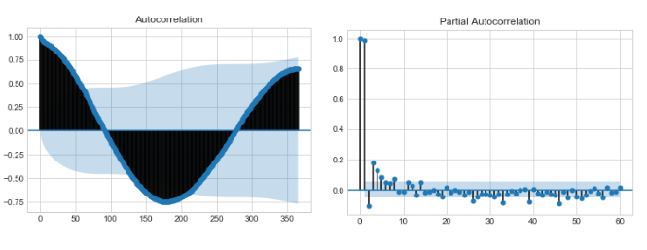
ARDL
Autocorrelation and Partial Autocorrelation of temperature
In case of autocorrelation, a significant correlation within lags of the temperature goes up to 60 as each lag is being compared to the one before it. Meanwhile, there is a totally different picture for the partial autocorrelation as is shows the correlation between each lag and the initial temperature observation (in our case it is June 13, 2015).

Slide 12

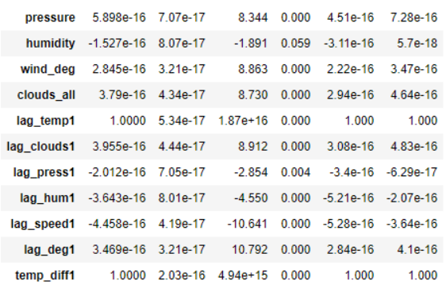
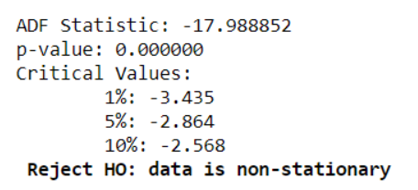
ARDL
Results
Main output
Stationarity of errors

Slide 13
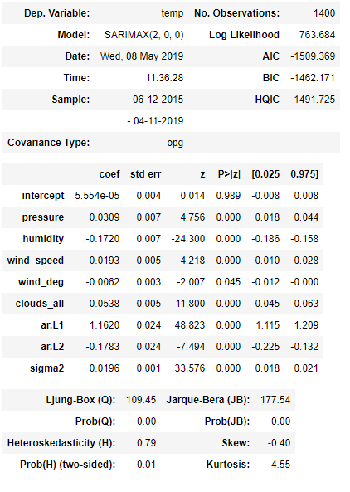
SARIMAX
Results
Day | Temperature
April 12, 2019 | 9.778953
April 13, 2019 | 9.746843
April 14, 2019 | 9.777626

Slide 14
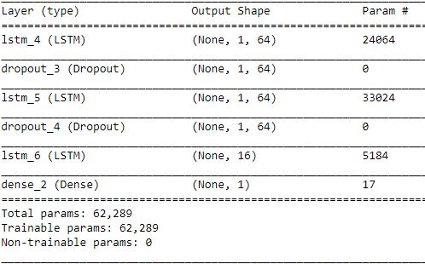
Neural Net
Results
Model(64, 64, 64, 64, 16, 1):
LSTM, Dropout, Dense
Loss-function: MSE
Optimizer: RMSprop
Metric: MAE
Epochs: 35
Training with more hyperparameters made overfitting.
Regularization methods: useless
Mean abs error: 0.05(scaled)

Slide 15
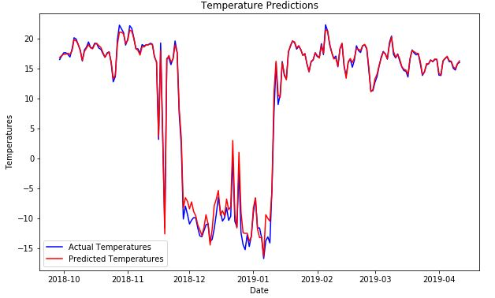
Results on Test set

Slide 16
Thanks!

